Slide 2
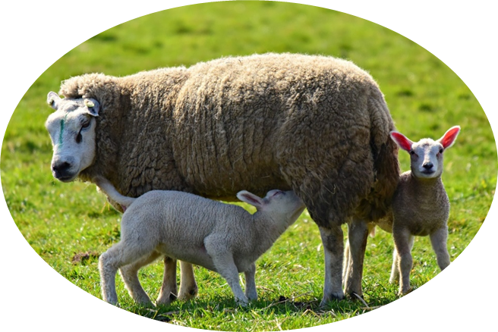

  What is reproduction (生殖)?
production of offspring (後代)
ensures the continuation of species

Slide 3

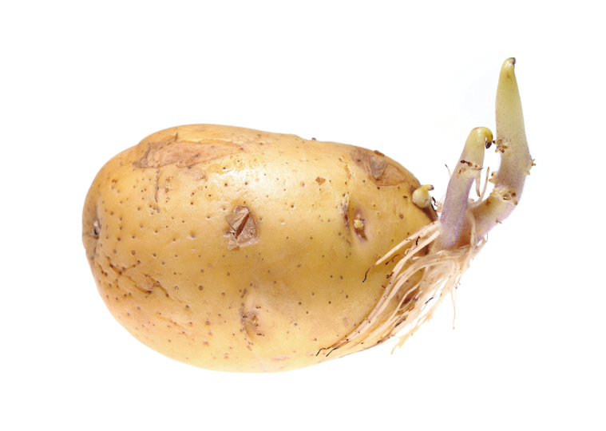
  What is reproduction (生殖)?
two main types:
asexual reproduction
(無性生殖)
sexual reproduction
(有性生殖)

Slide 4
  Asexual reproduction
production of offspring from one single parent without fusion of gametes
involves mitotic cell division only
all offspring have identical genetic make-up as the parent

Slide 5
  Sexual reproduction
production of offspring through the fusion of gametes (fertilization)
usually derived from two parents of different sexes
produced by meiotic cell division
offspring genetically different from the parents

Slide 6



  Sexual reproduction
male gamete (e.g. sperm)
fuse
zygote
female gamete (e.g. ovum)
mitotic cell division
offspring

Slide 7
  Asexual reproduction vs sexual reproduction
 | Asexual reproduction | Sexual reproduction
Fusion of gametes
Number of parents
No
Yes
Usually two;
one male and one female
One

Slide 8
  Asexual reproduction vs sexual reproduction
 | Asexual reproduction | Sexual reproduction
Type of cell division involved
Meiotic cell division for gamete formation;
Mitotic cell division only
Mitotic cell division for development of a zygote into an offspring

Slide 9
  Asexual reproduction vs sexual reproduction
 | Asexual reproduction | Sexual reproduction
Genetic make-up of offspring
Identical to the parent
Different from parents

Slide 10

✗
Sexual reproduction must involve two parents.
✓
Some organisms, e.g. tapeworm and most flowering plants, are bisexual. Their bodies have both male and female reproductive parts, so they can carry out sexual reproduction with only one single parent.

